Slide 1
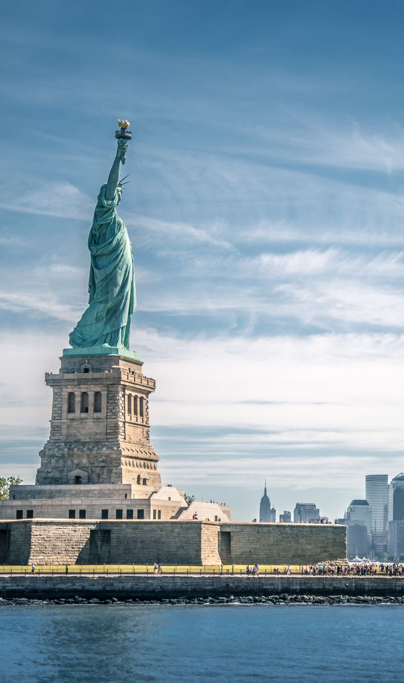
Open a Pizzeria in New York
Homero Welsh

Slide 2
Introducction
New York City's food culture includes an array of international cuisines influenced by the city's immigrant history. Central and Eastern European immigrants, especially Jewish immigrants from those regions, brought bagels, cheesecake, hot dogs, knishes, and delicatessens (or delis) to the city. Italian immigrants brought New York-style pizza and Italian cuisine into the city, while Jewish immigrants and Irish immigrants brought pastrami and corned beef, respectively. Chinese and other Asian restaurants, sandwich joints, trattorias, diners, and coffeehouses are ubiquitous throughout the city.

Slide 3
Bussines Problem
A client wants to open his business in Manhattan area, so I focus on that borough during my analysis. We define potential neighborhood based on the number of pizza places which are operating right in each neighborhood. Manhattan has full potential but also is a very challenging district to open a business because of high competition. A new pizza place should be open in an area that inadequate neighborhood in this way the resutaurant can attract more customers. Therefore, this analysis necessary to ensure that we have enough customers and that we are not so close to other sushi places.

Slide 4
Data Selection
To identify the characteristics of our competitors' venues in manhattan, we would first need to find out the number of pizza places in manhattan currently and their location.
We then used google map API to find their geographic coordinates based on their postal code addresses.
New york data luckily exists for free on the web. Feel free to try to find this dataset on your own, but here is the link to the dataset: https://geo.Nyu.Edu/catalog/nyu_2451_34572
I downloaded the files and placed it on the server
Also I took pizza places venues categories from foursquare 4bf58dd8d48988d1ca941735

